Slide 1
Outline
1. PULPino 介绍
2. PULPino 结构分析
3. PULPino falsh使用与结合Arduino库控制机械臂
4. PULPino 网络运行计划，对比PULP-NN
5. 项目计划
6. 补充：ModelSim安装

Slide 2
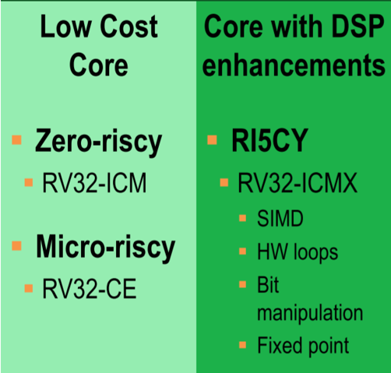
PULPino: A single-core RISC-V Soc
Microcontroller-style platform
Focused on one core
No cashes, no memory hierarchy
Available for FPGA
Taped out with UMC 65nm in JAN-2016
Available Core

Slide 3
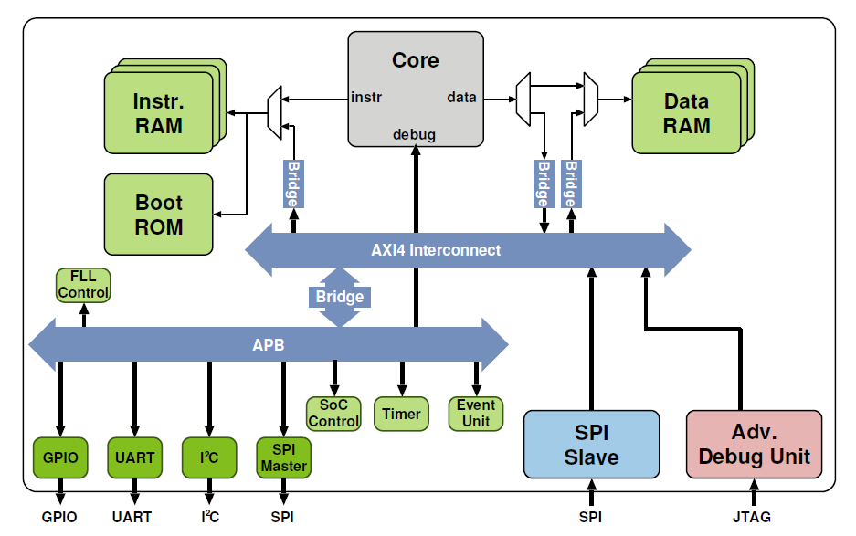
PULPino Structure

Slide 4
PULPino Structure
Boot ROM and SPI Master are 2 key parts in our MCU project!!!

Slide 5
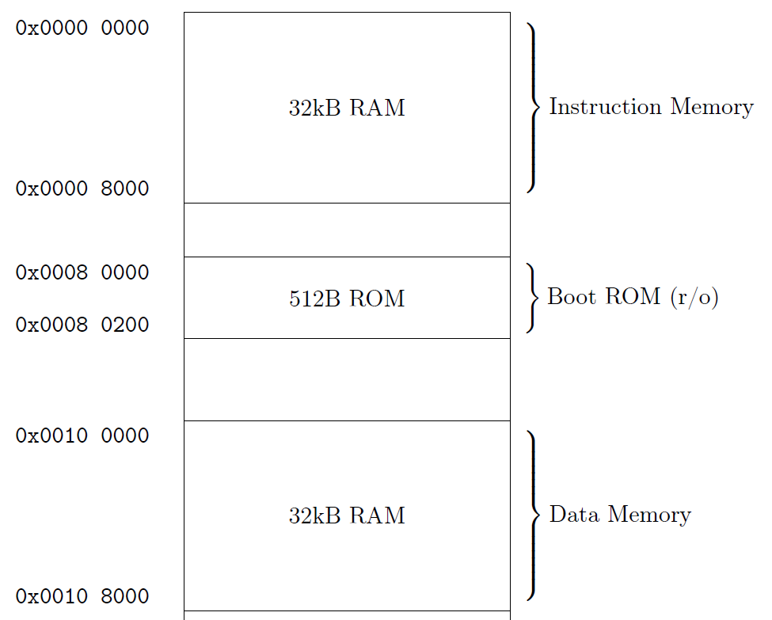
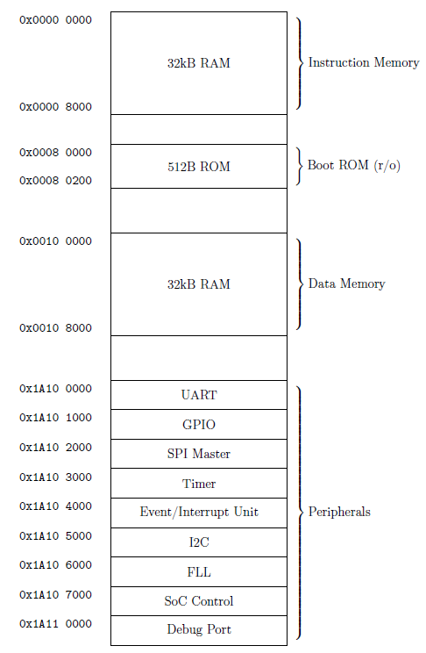
PULPino Memory Map
PULPino Starts to run with the Boot ROM and it can be modified in HDL code
Boot ROM can load the program from flash and initialize our Instruction MEM and Data MEM

Slide 6
PULPino without Flash
PULPino with Flash
Although we don’t use flash, as Instruction MEM and Data MEM are instances in our FPGA project, we can modify it to do the tasks.
The PULPino boot with Boot ROM and execute the instructions in Instruction MEM after initialize it with the program in flash

Slide 7
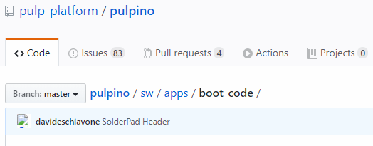
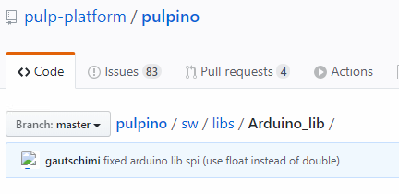
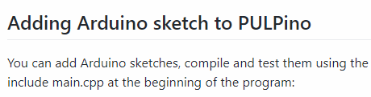
Implementation Problems and Some worthwhile solutions to try out
1. How to let the PULPino boot with Boot RAM and communicate with flash successfully?
Solutions:
2. How to get program which can perform some MCU tasks (like servo control)?
Solution:
SPI communicate and Boot setting can control by the boot_code part in the PULPino, learn it and modify it
It is illustrated in the PULPino official website that we can use Arduino Library to help us generate the program for PULPino
It can help us save a lot of time if we read their program and learn how to do it

Slide 8
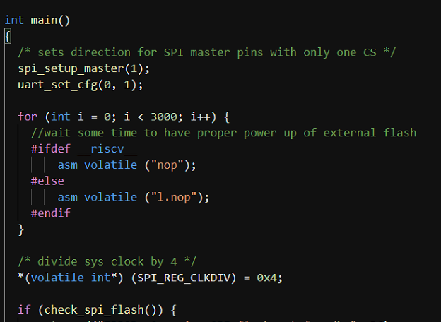
PULPino Booting设置
设置SPI端口与UART速率
延时等待FLASH上电
地址等参数的读取
写入Inst RAM
写入Data RAM
FLASH检查
设置启动地址并跳转
PULPino 启动流程
对于一般的flash，设置好端口，保证连接没问题，保证flash中的数据正确就可以，但目前还不了解flash CIM应该如何设置

Slide 9
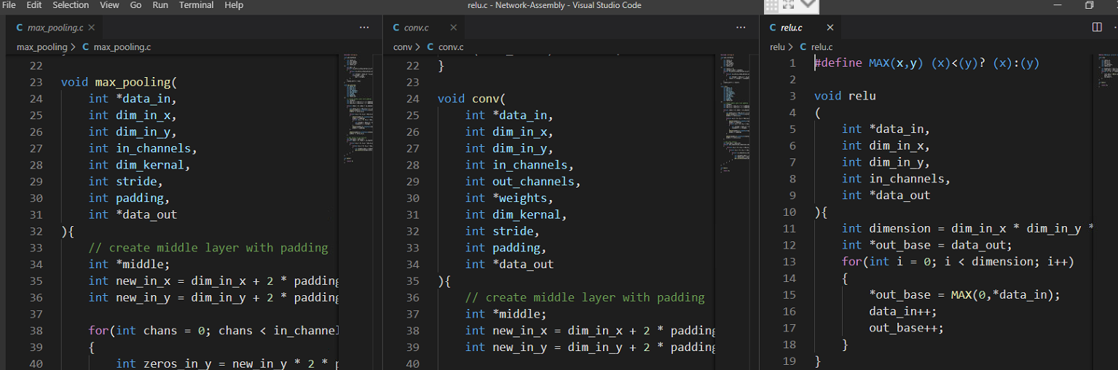
PULP-NN
What contained in PULP-NN?
The C implementation of some layers of Neural Network
SIMD Instructions
How about our MCU?
The MCU can not use the SIMD Instructions as it just have one core
The C implementation in PULP-NN base on SIMD insts, but we can implement it by ourselves
I already implement some layers of Neural Network and can be compiled by PULP tools

Slide 10
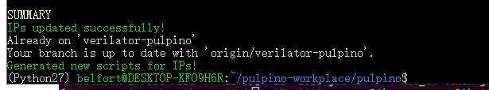
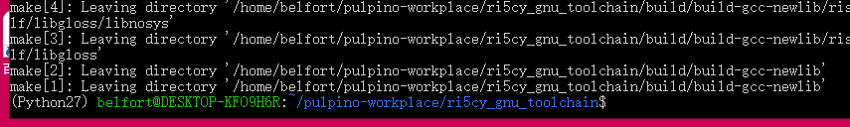
项目计划
当前已完成：
1. PULPino 项目环境配置
2. PULPino toolchain配置
3. 了解PULPino的boot配置
4. 初步完成一些网络模块
下一步计划：
1. 搭建仿真平台，研究如何模拟flash-in-computing
2. 结合板子使PULPino从Boot RAM启动并自动从flash加载程序运行
3. 结合Arduino工具，实现flash编程
4. 通过Arduino库实现机械臂控制
5. 在MCU上运行C语言实现的网络（包括Flash CIM的部分，但目前还不了解）

Slide 11
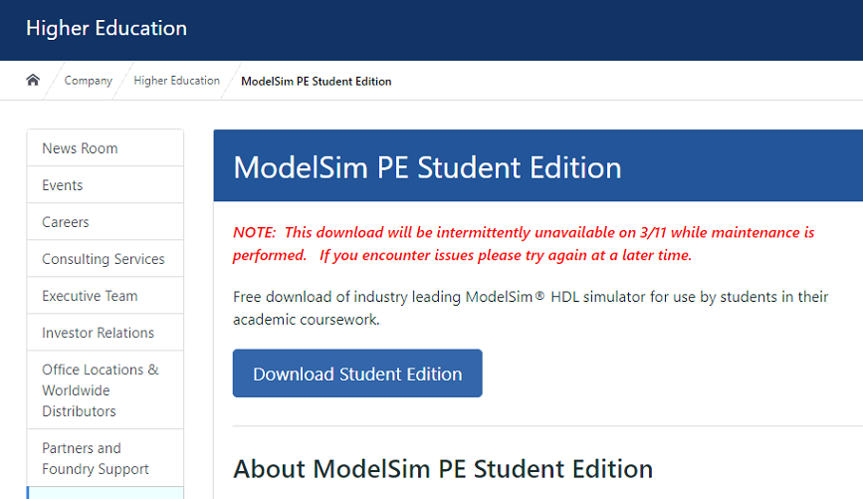
ModelSim 安装
标准版地址：https://www.intel.com/content/www/us/en/software/programmable/quartus-prime/model-sim.html
但标准版需要license和intel账号
学生版地址：https://www.mentor.com/company/higher_ed/modelsim-student-edition
可以申请ModelSim学生版，目前还未收到反馈

